Slide 1
DSTN Lecture 3
DSTN Lecture 3

Slide 2
Today’s Agenda
File System (Unix FS as an Example)
  Files & File Descriptors
  File Entries
  Virtual File System and v-node
  Local File System and i-node

Slide 3
Files and File Systems: Introduction
A file system is a logical abstraction for secondary (persistent) storage
  i.e. physical storage is partitioned into logical units
  Each logical unit has a file system – modeled as a tree for navigation
  Nodes of the tree are directories (internal) and files (terminal)
    In Unix directories are also files that store directory listings

Slide 4
Files and File Systems: Data Access Types
Persistent data may be accessed:
  in large sequential chunks or
  in small random records
File systems are typically designed to handle these two kinds of accesses respectively
Any standard OS includes built-in File System
  One or more file systems are supported
  e.g. ext, ext2, ext3, NTFS, FAT

Slide 5
Files in UNIX
Files are logical storage units as well as logical I/O streams in Unix
  i.e. access to each physical I/O device is supported through a logical abstraction, which is a file
A file is contained in a directory (which is also supported as a file)
Unix treats network connections and storage devices through the same high level abstraction:
  Socket access (by applications) is very similar to I/O on devices

Slide 6
File Descriptors in UNIX
An application opening a file gets a “file descriptor” object
  File descriptor is held by the user process
    Each process maintains a descriptor table for holding descriptors (nonnegative integer) of open files.
  Typical operations on file descriptor:
    read, write, select, ioctl, close
  Each descriptor object in turn points to a “file entry” in a shared table maintained by the kernel
    The file entry points to a data structure for maintaining specific file instance information and state associated with an instance.
      This data structure is opaque to operations manipulating the file entry.
      Underlying object instances cannot manipulate the file entry

Slide 7
Open Files in UNIX: File Entries [1]
read/write system calls do not take an offset as an argument
  They update the current file offset which determines the position for the next read/write
lseek system call can be used to set the offset
More than one process may open the same file
  i.e. each process needs its own offset
  i.e. each open system call allocates a new file entry (in the kernel table) which stores the offset

Slide 8
Open Files in UNIX: File Entries [2]
Access Control Semantics is enforced at the file descriptor level.
  There are flags in the descriptor recording access permissions as “read”, “write”, or “read-write”
There is also an “append” flag in the descriptors
  Allows file to be treated as a FIFO stream
    E.g. Multiple processes may be writing to the same file

Slide 9
Open Files in UNIX: File Entries [3]
Each “file entry” has a reference count
  Multiple descriptors may refer to the same file entry:
    Single Process: dup system call
    Multiple Processes: child process after a fork inherits file structures
      A read or write by either process (via the corresponding descriptor) will advance the file offset
      This allows interleaved input/output from/to a file

Slide 10
Virtual File Systems and V-nodes
File descriptors and file entries keep track of per process, per I/O (sequence) state.
For each open file a virtual node (v-node) is also available in memory.
  All file entries corresponding to the file, point to the v-node and the v-node maintains a reference count.
  Buffers (for I/O on a file) are associated with the v-node.
    Each v-node has a clean buffers list and a dirty buffers list
  Each v-node is also associated with a mount data structure (that corresponds to a mounted file system)

Slide 11
Virtual File System and v-nodes
A v-node is an in-memory abstraction for a file
  i.e. it acts a proxy to a physical file store data structure that abstracts away from the details of the file store.
    For instance, irrespective of whether a file is stored remotely or locally, system call operations flow through a file entry to a v-node
A v-node is similar to an interface in an object-oriented system where multiple implementations of the interface are possible.
  The underlying implementation would correspond to the physical file.
    For example, an i-node for a local file or nfs-node for a remote file.

Slide 12
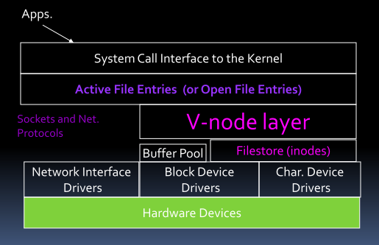
Unix File System

Slide 13
Local File System and i-node
For a local file system an index node (i-node) is an in memory copy of a file handle i.e.
  Each file stored in a local file system (e.g. a disk) has i-node associated with it.
  All i-nodes are stored (along with the file system) on disk.
  Copies of i-nodes for active (i.e. open) files are kept in memory in a hash table (i-node table) hashed by i-node number which is a unique identifier.
Each i-node provides information for accessing a file data from a local store (e.g. a disk).
  It also stores file meta-data.

Slide 14
Local File Store
Each disk drive has one or more partitions
  Typical (1-1) mapping: file store <==> partition
File store is responsible for
  Creation, storage, retrieval and removal of files
    New file creation – i-node allocation
    Flat name space
    Allocation of new blocks to files as files grow.
Naming, access control, locking, attribute manipulation are all handled by the file system management layer above the file store

Slide 15
Organization of File store
Berkeley Fast File System (FFS) model:
  A file system is described by its superblock
    Located at the beginning of the file system
    Possibly replicated for redundancy
  A disk partition is divided into one or more cylinder groups i.e. a set of consecutive cylinders:
    Each group maintains book-keeping info. including
      a redundant copy of superblock
      Space for i-nodes
      A bitmap of available blocks and
      Summary usage info.
Cylinder groups are used to create clusters of allocated blocks to improve locality.

Slide 16
Local File Store- Storage Utilization
Data layout – Performance requirement
  Large blocks of data should be transferable in a single disk operation
So, logical block size must be large.
  But, typical profiles primarily use small files.
Internal Fragmentation:
  Increases from 1.1% for 512 bytes logical block size, 2.5% for 1KB, to 5.4% for 2KB, to an unacceptable 61% for 16KB
I-nodes also add to the space overhead:
  But overhead due to i-nodes is about 6% for logical block sizes of 512B, 1KB and 2KB, reduces to about 3% for 4KB, and to 0.8% for 16KB.
One option to balance internal fragmentation against improved I/O performance is
  to maintain large logical blocks made of smaller fragments

Slide 17
Local File Store – Layout [1]
Global Policies:
  Use summary information to make decisions regarding placement of i-nodes and disk blocks.
    Routines responsible for deciding placement of new directories and files.
  Layout policies rely on locality to cluster information for improved performance.
    E.g. Cylinder group clustering
Local Allocation Routines.
  Use locally optimal schemes for data block layouts.

Slide 18
Local File Store – Layout [2]
Local allocators use a multi-level allocation strategy:
1. Use the next available block that is rotationally closest to the requested block on the same cylinder
2. If no blocks are available in the same cylinder use a block within the same cylinder group
3. If the cylinder group is full, choose another group by quadratic hashing.
4. Search exhaustively.

Slide 19
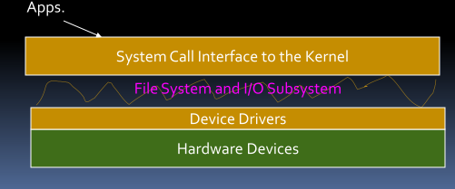
OS Support for I/O
System calls form the interface between applications and OS (kernel)
  File System and I/O system are responsible for
    Implementing system calls related to file management and handling input/output.
Device drivers form the interface between the OS (kernel) and the hardware

Slide 20
I/O in UNIX - Example
Application level operation
  E.g. printf call
OS (kernel) level
  System call bwrite
Device Driver level
  Strategy entry point – code for write operation
Device level
  E.g. SCSI protocol command for write

Slide 21
I/O in UNIX - Devices
I/O system is used for
  Network communication and virtual memory (Swap space)
Two types of devices
  Character devices
    Terminals, line printers, main memory
  Block devices
    Disks and Tapes
    Buffering done by kernel

Slide 22
I/O in UNIX – Device Drivers
Device Driver Sections
  Auto-configuration and initialization Routines
    Probe and initialize the device
  Routines for servicing I/O requests
    Invoked because of system calls or VM requests
    Referred to as the “top-half” of the driver
  Interrupt service routines
    Invoked by interrupt from a device
      Can’t depend on per-process state
      Can’t block
    Referred to as the “bottom-half” of the driver

Slide 23
I/O Queuing and Interrupt Handling
Each device driver manages one or more queues for I/O requests
  Shared among asynchronous routines – must be synchronized.
  Multi-process synchronization also required.
Interrupts are generated by devices
  Signal status change (or completion of operation)
  DD-ISR invoked through a glue routine that is responsible for saving volatile registers.
  ISR removes request from queue, notifies requestor that the command has been executed.

Slide 24
I/O in UNIX – Block Devices and I/O
Disk sector sized read/write
  Conversion of random access to disk sector read/write is known as block I/O
  Kernel buffering reduces latency for multiple reads and writes.

Slide 25
Device Driver to Disk Interface
Disk Interface:
  Disk access requires an address:
    device id, LBA OR
    device id, cylinder #, head#, sector #.
  Device drivers need to be aware of disk details for address translation:
    i.e. converting a logical address (say file system level address such as i-node number) to a physical address (i.e. CHS) on the disk;
    they need to be aware of complete disk geometry if CHS addressing is used.
  Early device drivers had hard-coded disk geometries.
    This results in reduced modularity –
      disks cannot be moved (data mapping is with the device driver);
      device driver upgrades would require shutdowns and data copies.

Slide 26
Disk Labels
Disk Geometry and Data mapping is stored on the disk itself.
  Known as disk label.
  Must be stored in a fixed location – usually 0th block i.e. 0th sector on head 0, cylinder 0.
  Usually this is where bootstrap code is stored
    In which case disk information is part of the bootstrap code, because booting may require disk access.

Slide 27
Buffering
Buffer Cache
  Memory buffer for data being transferred to and from disks
  Cache for recently used blocks
    85% hit rate is typical
    Typical buffer size = 64KB virtual memory
    Buffer pool – hundreds of buffers
Consistency issue
  Each disk block mapped to at most one buffer
  Buffers have dirty bits associated
  When a new buffer is allocated and if its disk blocks overlap with that of an existing buffer, then the old buffer must be purged.

Slide 28
Buffer Pool Management
Buffer pool is maintained as a (separately chained) hash table indexed by a buffer id
The buffers in the pool are also in one of four lists:
  Locked list:
    buffers that are currently used for I/O and therefore locked and cannot be released until operation is complete
  LRU list:
    A queue of buffers – a recently used item is added at the rear of the queue and when a buffer is needed one at the front of the queue is replaced.
    Buffers staying in this queue long enough are migrated to an Aged list
  Aged List:
    Maintained as a list and any element may be used for replacement.
  Empty List
When a new buffer is needed check in the following order:
  Empty List, Aged List, LRU list

Slide 29
Flash Memory
Flash chips are arranged into blocks which are typically 128KB on NOR and 8KB on NAND flash
All flash cells are preset to one. These cells can be individually programmed to zero
  Burt resetting bits from zero to one cannot be done individually, can be done only by resetting or erasing a complete block
The lifetime of a flash chip is measured in such erase cycles, with the typical lifetime being 100,000 erases per block
  Erase count per block should be evenly distributed across all the blocks for better life time of the flash chip
  Process is known as “wear leveling”

Slide 30
Traditional File System: Erase- Modify-Write back
Use 1:1 mapping from the emulated block device to the flash chip
  read the whole erase block, modifying the appropriate part of the buffer, erase and rewrite the entire block
    No wear leveling…!
    Unsafe due to power loss between erase and write back
Slightly better method
  by gathering writes to a single erase block and only performing the erase/modify/write back procedure when a write to a different erase block is requested.

Slide 31
Journaling File System(JFS)
How to provide wear leveling…?
  emulated block device are stored in varying locations on the physical medium
  needs to keep track of the current location of each sector in the emulated block device
    Use of Translation Layer to keep track of current mapping
      It is a form of Journaling File System

Slide 32
JFFS Storage Format
It is a log structured file system
Nodes containing data and metadata are stored on the flash chips sequentially, progressing strictly linearly through the storage space available.

Slide 33
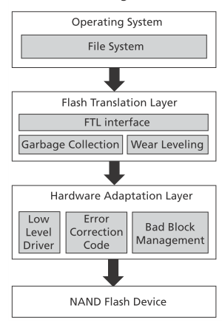
Wear Leveling

Slide 34
Flash Memory: Operations
Out-place updating is usually done to avoid erasing operations on every write
  Latest copy of data is “live”
Page meta-data
  “Live” vs “dead”
  “Free” pages are unused pages
Cleaning
  Required when free pages are not available
  Erasure is done per block
    May require copying of live data
Some blocks may be erased more than others
  “Worn” pages

Slide 35
File System and Flash Access
Although File Systems abstract out device details
  Most file system internals were designed for semi-random access models:
    i.e. notions of blocks/sectors, block addresses, and buffers tied to blocks are incorporated into many file systems
      E.g. Block devices in Unix file systems
So, either file systems are redesigned for flash
Or, device drivers handle flash memory access and file systems use the same access models
  Require a Flash Translation Layer that emulates a block device

Slide 36
Topics
I/O Techniques
  Polling
  Interrupt driven
  DMA

Slide 37
I/O Techniques
Polling:
  CPU check on the status of an I/O device by reading a memory address which is associated with an I/O device
  Pseudo-asynchronous
    Processor inspects (multiple) devices in rotation
  Cons
    Processor may still be forced to do useless work or wait or both
  Pros
    CPU can determines how often it needs to poll

Slide 38
I/O Techniques
Interrupts:
  Processor initiates I/O by requesting an operation with the device.
  May disconnect if response can’t be immediate, which is usually the case
  When device is ready with a response it interrupts the processor.
    Processor finishes I/O with the device.
  Asynchronous but
    Data transfer between I/O device and memory still requires processor to execute instructions.

Slide 39
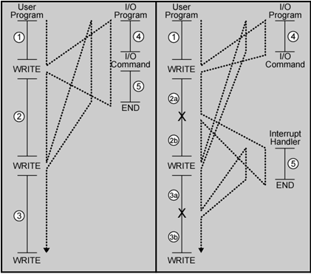
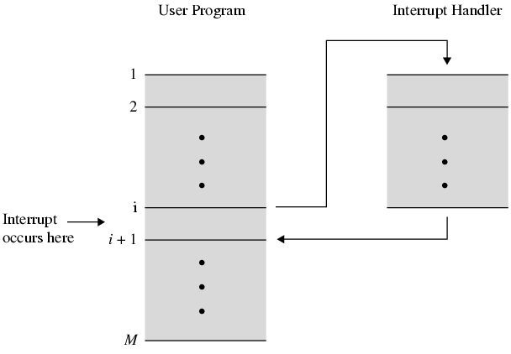
I/O Techniques: Interrupts

Slide 40
I/O Techniques
Direct Memory Access
  Processor initiates I/O
  DMA controller acts as an intermediary:
    interacts with the device,
    transfers data to/from memory as appropriate, and
    interrupts processor to signal completion.
  From the processor’s perspective DMA controller is yet another device
    But one that works at semiconductor speeds

Slide 41
I/O Techniques
I/O Processor
  More sophisticated version of DMA controller with the ability to execute code: execute I/O routines, interact with the O/S etc

Slide 42
Topics
I/O Path From CPU to Storage
  BUSES
  PCI (Peripheral Component Interconnect)Bus as an example

Slide 43
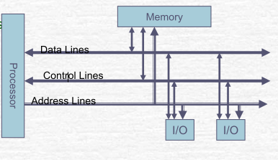
What is a Bus ?
A bus is
  a shared communication link between sub- systems of a computer and
  an associated protocol for communication
    Note: A protocol is a set of rules - often specified formally.
E.g.
  Single Shared bus
  Separate system bus
  and I/O Bus

Slide 44
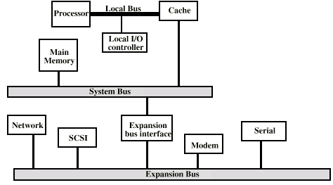
Traditional Bus Architecture
Multi bus architecture
  To avoid contention
  Better Performance
  Device requirements are different

Slide 45
Bus Arbitration
More than one module controlling the bus
  e.g. CPU and DMA controller
Only one module may control bus at one time
Arbitration may be-
  Centralised
    Single hardware device controlling bus access
  Distributed
  Each module may claim the bus
    Control logic on all modules

Slide 46
Timing
Co-ordination of events on bus
Synchronous
  Events determined by clock signals
  Control Bus includes clock line
  All devices can read clock line
  Usually a single cycle for an event
Asynchronous
  Events are not synchronized with clock signals

Slide 47
Common Bus Protocols: PCI
PCI Bus
  Created by INTEL in 1993
  Synchronous bus with 32 bits operating at a clock rate of 33 MHz
  Transfer rate 132 MB/s
  PCI-X extended the bus to 64 bits and either 66 MHz or 133 MHz for data rates of 528 MB/s or 1064 MB/s

Slide 48
PCI BUS Lines
PCI Bus Lines (50) (required)
Systems lines
  Including clock and reset
Address & Data
  32 time mux lines for address/data
  Interrupt & validate lines
Interface Control
  Control the timings of transactions
Arbitration
  Not shared
  Direct connection to PCI bus arbiter
Error lines
  Used to report parity and other errors

Slide 49
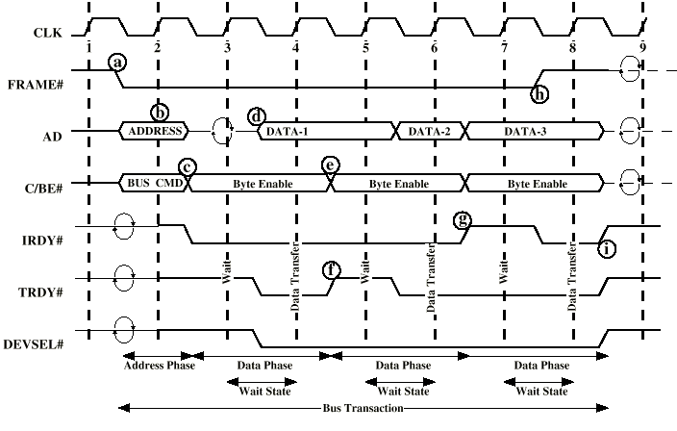
PCI Operation Example: Read

Slide 50
Topics
SCSI Bus Protocol
  Bus components
  SCSI Devices
  SCSI commands
  SCSI r/w operation

Slide 51
SCSI: I/O Path from CPU to Storage
Stands for Small Computer System Interface
  Asynchronous, parallel bus
  Allows multiple bus masters
  Commonly used for high-end Storage devices
Several standards
  Earliest Standard
    No. of wires (50)
    8 data lines
    data transfer rate (5MB/s)
    wire length(25m)

Slide 52
SCSI Bus Standard
Fast SCSI
  Doubled clock rate, data transfer up to 10MB/s
Wide SCSI
  16 data lines
  Fast Wide SCSI – 20 MB/s
Ultra SCSI
  8 data lines – data transfer rate 20MB/s
  Ultra Wide SCSI – 16 data lines – data transfer 40 MB/s
  Ultra320 - 16 data lines – data transfer 320 MB/s
Serial Attached SCSI (SAS) and iSCSI (IP over SCSI)

Slide 53
SCSI – Components Model
All devices are connected to a bus through a SCSI controller
  e.g. a host adaptor on the processor side
  e.g. a disk controller for a hard disk device
2 types of devices
  Initiators or Targets
    Initiator has the ability to select a target and send commands specifying operations
    Target has the ability to execute the operations based on the commands received
    Data transfers are controlled by the targets

Slide 54
SCSI Devices
Devices are identified through controllers
Device Identification
  Identifiers: Narrow SCSI (8 devices)
    0-7 in increasing order of priority
  Identifiers: Wide SCSI (16 devices)
    8-15, 0-7 in increasing order of priority
  Identifier assignment is
    physical (through jumpers or switches), or
    programmatic (through BIOS firmware in adapter)
Logical devices
  Each Drive/Disk is assigned a Logical Unit Number (LUN) for addressing
  A Single physical device may be divided into logical devices each with a LUN (Logical Unit Number)

Slide 55
SCSI Command Protocol
Communication between initiator and target
  Command sent in a Command Descriptor Block
    1 byte of opcode followed by
    5+ bytes of command-specific parameters
  Target (eventually) sends a status code byte
    Success, or busy, or Check Condition (i.e. error)

Slide 56
SCSI Command Protocol
Command Types
  Non-data, Write, Read, Bidirectional
  e.g.
    Test Unit Ready
    Inquiry
    Start/Stop Unit
    Request Sense (for error)
    Read Capacity
    Format Unit
    Read (4 variants)
    Write (4 variants)

Slide 57
Command Descriptor Block (CDB)
Opcode
LUN (3 bits)
e.g. for Read
  Read (6): 21 bits LBA, 1 byte transfer length
  Read(10): 32 bit LBA, 2 byte transfer length
  Read(12): 32 bit LBA, 4 byte transfer length
  Read Long for ECC-Compliant data

Slide 58
SCSI – State Transition – Bus Phases
Bus Free Phase
  Bus is not being used by anyone
Arbitration Phase
  One or more initiators request use of the bus and
    the one with the highest priority (SCSI ID order) is allowed to proceed
Selection / Reselection phase
  Initiator asserts BUS BUSY signal and
    places target’s address on the bus thus establishing a connection/session
  Re-selection applies for a target resuming an interrupted operation:
    target asserts BUS BUSY signal and places initiator’s address on the bus.
Message
  Exchange of control messages between initiator and target
Command
  Initiator sends command to target
Data
  Data exchange (as part of a read/write operation)
Status
  Status of a command.

Slide 59
SCSI – State Transition – Bus Phase Sequence [1]
For a read operation:
1. When bus is free, initiator enters into arbitration (with other possible initiators)
2. On arbitration, initiator selects the bus and places target address on bus
3. Target acknowledges selection by a message
4. Initiator sends command
5. Target acknowledges command by a message
6. Target devices places (read) data on bus
7. Initiator acknowledges data by a message
8. Target sends status
Assumption:
  Target holds the bus while it is reading – this acceptable only for simple devices and small read delays.
Exercise: Modify the above sequence for a write operation.

Slide 60
SCSI – State Transition – Bus Phase Sequence [2]
For a read operation:
1. When bus is free, initiator enters into arbitration (with other possible initiators)
2. On arbitration, initiator selects the bus and places target address on bus
3. Target acknowledges selection by a message
4. Initiator sends command
5. Target acknowledges command by a message
6. Target sends “Disconnect” message to initiator
7. Bus is released
8. When target is ready with (read) data, target reselects bus and places initiator address on bus
9. Initiator acknowledges selection by a message
10. Target sends data.
11. Initiator acknowledges data by a message
12. Target sends status
Question: Modify the above sequence for a write operation.

Slide 61
SCSI – State Transition – Bus Phase Sequence [3]
For a sequence of read-write operations:
  Commands can be chained – i.e. a sequence of I/O operations initiated by a single initiator on the same target.
  In this case, one arbitration step and one selection phase are enough.
For large data transfers:
  Target could “disconnect” multiple times i.e. data transfer may be interrupted more than once.
    If the target decides to disconnect, target sends a “save data pointer” message to the initiator before the “disconnect” message
    A corresponding “restore data pointer” message is required after bus has been reselected (i.e. data transfer is about to resume).
SCSI controllers permit at most two sequences (i.e. connections/sessions) to be interleaved.

Slide 62
SCSI – Command Queuing
SCSI enables target devices to accept multiple requests before finishing any of them
  Target devices must maintain queue outstanding requests
  Also referred to as Tagged Command Queuing
  In SATA this is referred to as Native Command Queuing
SCSI-3 permits queue lengths up to 64
  In practice, most SCSI controllers (based on traditional parallel SCSI) support a queue length of 256
ATA/SATA permits queue lengths up to 32.

Slide 63
SCSI – Command Queuing
Command Queuing is useful
  For initiator to offload I/O operations instead of sequencing them itself.
  For amortizing seek and rotation times over multiple accesses thereby reducing the average access time:
    Controller must have support for ordering the accesses so that seek time is minimized or rotation time is minimized or both.

Slide 64
Error Correction -In channel
SCSI supports read/write operations with error correction code (ECC)
  ECC uses redundant bits for error correction
  Most modern disks have “out-of-band” ECC per disk sector
    This is used internally by the controller to verify whether any bit errors have occurred during storage.

